Slide 1


[ Data Visualization & story telling ]

Slide 2


Today's agenda
Project recap
Problem
The Analytics team
Process
Insights
Summary

Slide 3


II Social Buzz is fast growing technology need to adapt quickly to its global scale.
Accenture has begun a 3 month POC focusing on
these tasks:
- An audit of social buzz’s big data processing
- Recommendations for successful IPO
- Analysis to find top 5 categories of content
Project Recap

Slide 4


Problem
I have to work 7 datasets and each dataset contains different columns and values. And then I have provided the data model which shows the relationship between all the dataset and any link that can be used to merge the table.
Steps involved:
Requirement gathering, Data cleaning, Data Modeling

Slide 5
Senior Industry Analyst
Tim Pike
The Analytics team
Investment Analyst
Steven Shaw
Data Analyst
Hamna Qaseem

Slide 6

Requirement Gathering
Process
1
Data Understanding
2
Data Cleaning
3
Data Modeling
4
Meaningful insights
5

Slide 7


Insights
After understanding the data so I select the dataset with which need to complete analysis. This include Reaction, Reaction Types and Content.
To clarify why I made this selection:
The brief carefully it states that the client wanted to see “An analysis of their content categories showing the top 5 categories with the largest popularity”.
As explained in the data model, popularity is quantified by the “Score” given to each reaction type.
We therefore need data showing the content ID, category, content type, reaction type, and reaction score.
So, to figure out popularity, we’ll have to add up which content categories have the largest score.

Slide 8
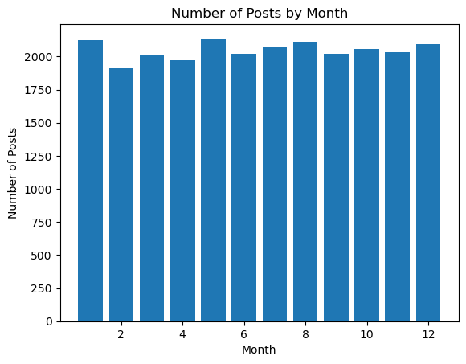
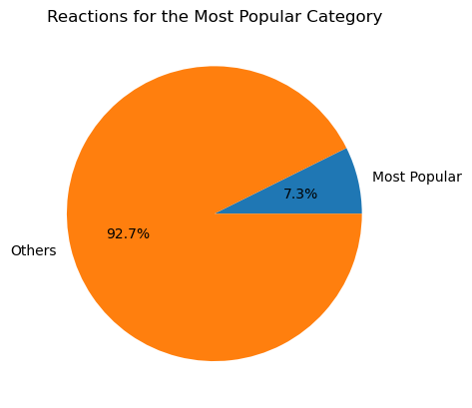
Second: Clean the data by:
removing rows that have values which are missing,
changing the data type of some values within a column, and
removing columns which are not relevant to this task.
My end result include three cleaned data sets.
End result should be Top 5 categories this can be come up by adding up the total score for each category.

Slide 9


Social Buzz was founded by two former engineers from a large social media conglomerate, one from London and the other from San Francisco. Social Buzz emphasizes content by keeping all users anonymous, only tracking user reactions on every piece of content. There are over 100 ways that users can react to content, spanning beyond the traditional reactions of likes, dislikes, and comments. This ensures that trending content, as opposed to individual users, is at the forefront of user feeds.
Summary

Slide 10

Thank you!
ANY QUESTIONS?

